Slide 1

Chapter 7
Transmission Media
7.<number>
Copyright © The McGraw-Hill Companies, Inc. Permission required for reproduction or display.

Slide 2
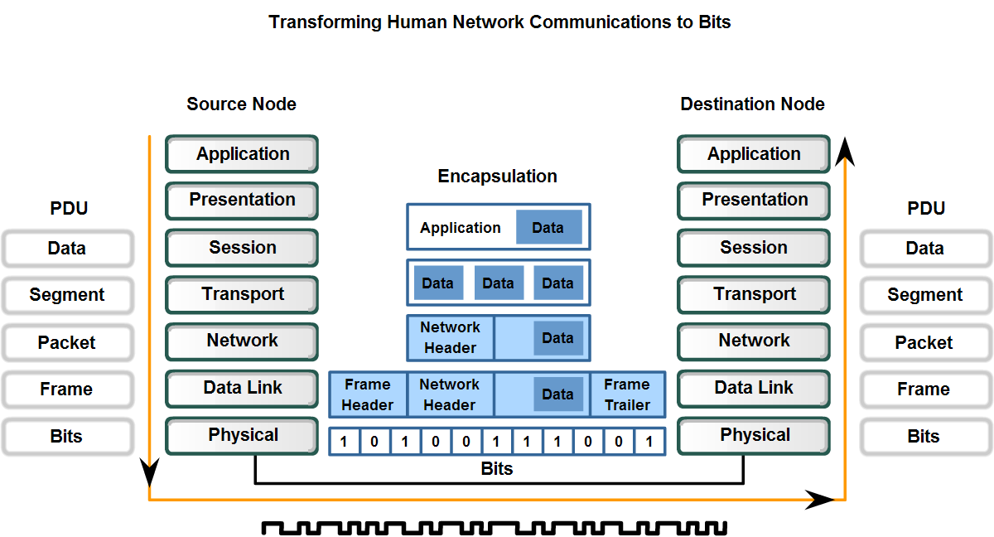
Physical Layer
The purpose of the Physical layer is to create the electrical, optical, or microwave signal that represents the bits in each frame.

Slide 3

Figure 7.1 Transmission medium and physical layer
7.<number>

Slide 4
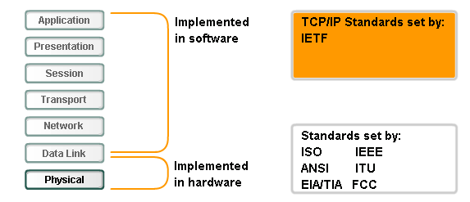
Standards
Physical layer standards:
  Physical and electrical properties of the media
  Mechanical properties (materials, dimensions, pinouts) of the connectors
  Bit representation by the signals (encoding)
  Definition of control information signals

Slide 5
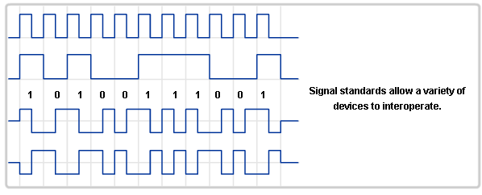
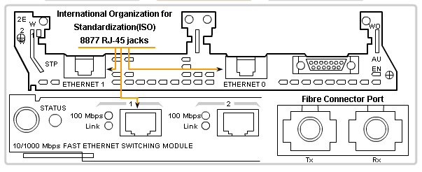
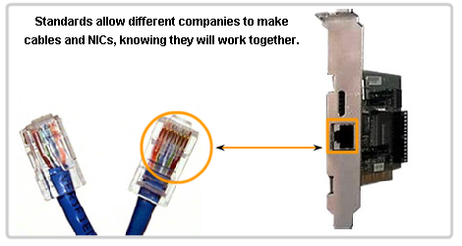
Standards
Signals
Connectors
Cables

Slide 6

Figure 7.2 Classes of transmission media
7.<number>

Slide 7
7-1 GUIDED MEDIA
Guided media, which are those that provide a conduit from one device to another, include twisted-pair cable, coaxial cable, and fiber-optic cable.
Topics discussed in this section:
Twisted-Pair Cable
Coaxial Cable
Fiber-Optic Cable
7.<number>

Slide 8
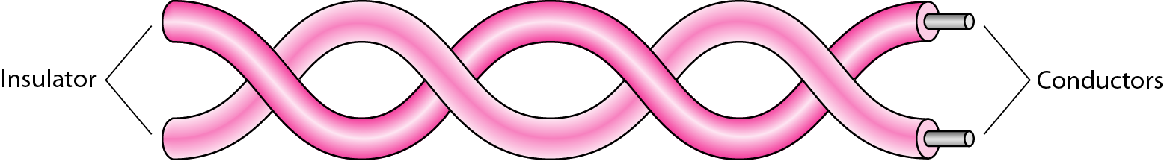
Figure 7.3 Twisted-pair cable
7.<number>

Slide 9

Figure 7.4 UTP and STP cables
7.<number>

Slide 10
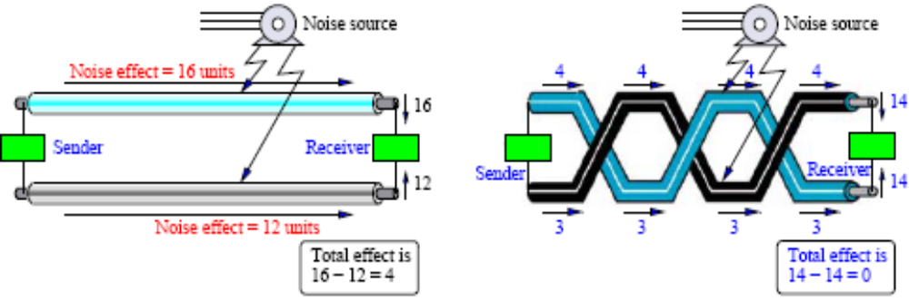
Effect of Noise on Parallel and Twisted-Pair Lines
Twisting allows each wire to have approximately the same noise level and reduces crosstalk.

Slide 11

Table 7.1 Categories of unshielded twisted-pair cables
7.<number>

Slide 12

Figure 7.5 UTP connector
7.<number>

Slide 13
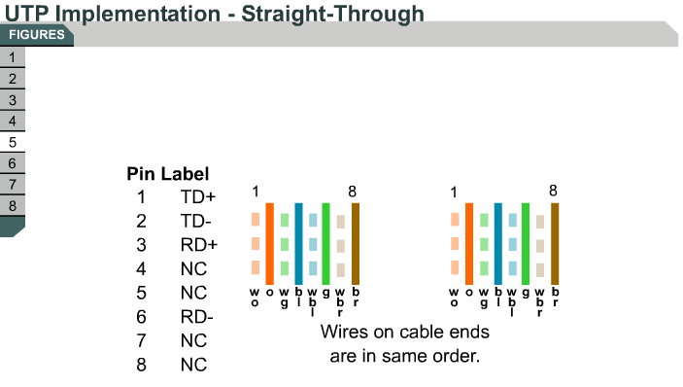

Slide 14
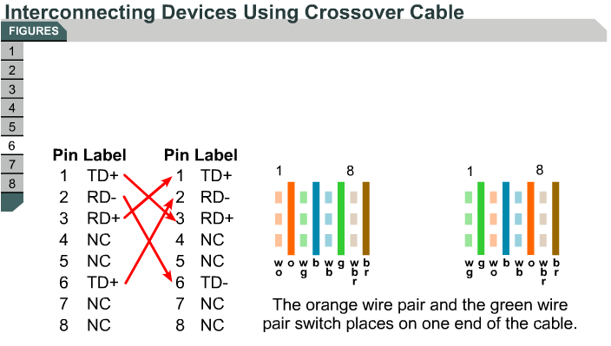

Slide 15
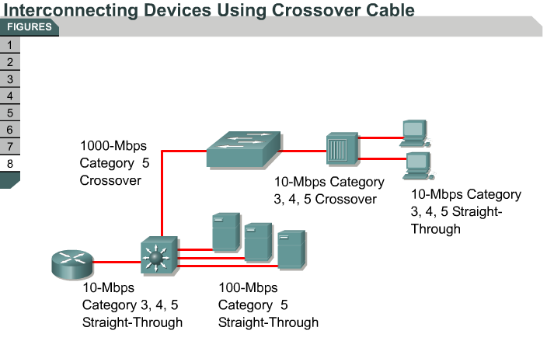
Use straight-through cables for…
Switch to router
Switch to PC or server
Hub to PC or server
Use crossover cables for…
Switch to switch
Switch to hub
Hub to hub
Router to router
PC to PC
Router to PC

Slide 16

Figure 7.6 UTP performance
7.<number>

Slide 17
Twisted Pair
Applications:
  Most common medium
  Telephone network
    Between house and local exchange (subscriber loop)
  Within buildings
    To private branch exchange (PBX)
  For local area networks (LAN)
    10Mbps ,100Mbps, 1Gbps
Pros
  Cheap and easy to work with
Cons
  Low data rate and short range

Slide 18

Figure 7.7 Coaxial cable
7.<number>

Slide 19

Table 7.2 Categories of coaxial cables
7.<number>

Slide 20

Figure 7.8 BNC connectors
7.<number>

Slide 21

Figure 7.9 Coaxial cable performance
7.<number>

Slide 22

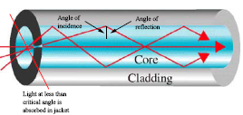
Fiber Optic Cable
Physical description:
  Optical Signal is carried by photon pulses through thin (8 to 10 microns) glass strands (optical fibers)
  light waves are produced either by Light emitting diodes (LEDs) or injection laser diode (ILD).
  at transmitting and receiving end, signal is converted from and reconverted to electrical form by optical modems such as an avalanche photo diode.

Slide 23
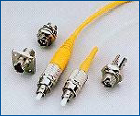

Fiber Optic Cable

Slide 24
Optical Fiber - Transmission Characteristics
Act as wave guide for 10¹⁴ to 10¹⁵ Hz
  Portions of infrared and visible spectrum
Light Emitting Diode (LED)
  Cheaper
  Wider operating temp range
  Last longer
Injection Laser Diode (ILD)
  More efficient
  Greater data rate
Wavelength Division Multiplexing

Slide 25
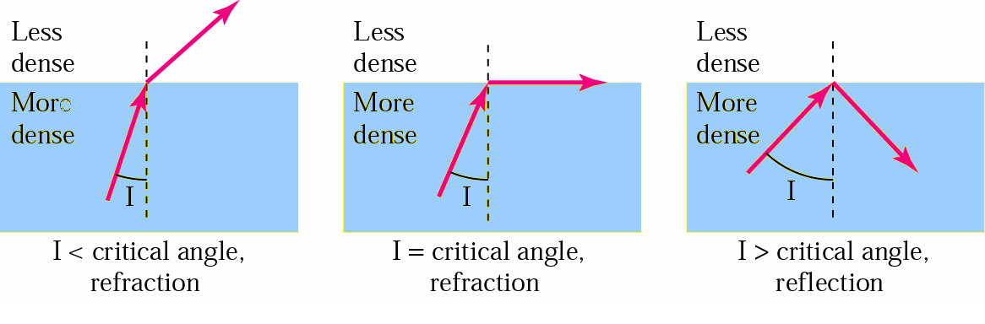
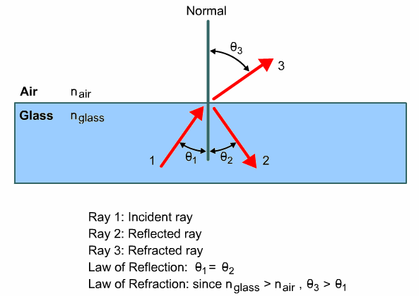
Bending of light ray

Slide 26
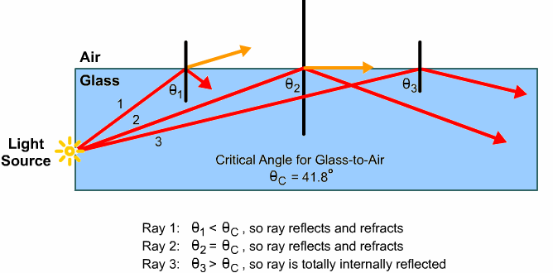
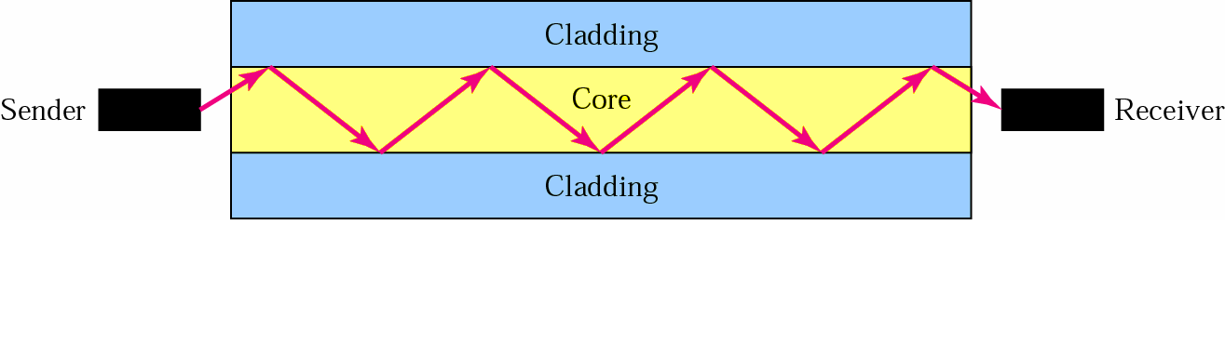
Optical fiber

Slide 27

Figure 7.12 Propagation modes
7.<number>

Slide 28

Figure 7.13 Modes
7.<number>

Slide 29
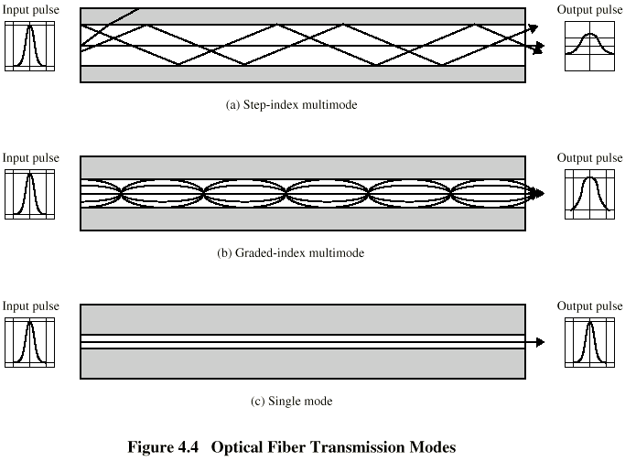
Optical Fiber Transmission Modes
multimode step-index fiber
  the reflective walls of the fiber move the light pulses to the receiver
multimode graded-index fiber
  acts to refract the light toward the center of the fiber by variations in the density
single mode fiber
  the light is guided down the center of an extremely narrow core

Slide 30
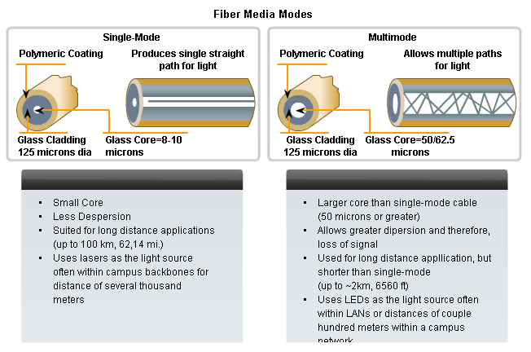
Single Mode Vs Multimode

Slide 31

Table 7.3 Fiber types
7.<number>

Slide 32

Figure 7.14 Fiber construction
7.<number>

Slide 33

Figure 7.15 Fiber-optic cable connectors
7.<number>

Slide 34
Optical Fiber - Benefits
Greater capacity
  Data rates of hundreds of Gbps
Smaller size & weight
Lower attenuation
Electromagnetic isolation
Greater repeater spacing
  10s of km at least
Immunity to corrosive materials
More immune to tapping

Slide 35
Challenges
More expensive (usually) than copper media over the same distance (but for a higher capacity)
Different skills and equipment required to terminate and splice the cable infrastructure
More careful handling than copper media
Unidirectional – so two fiber optic cables

Slide 36
Optical Fiber - Applications
  Long-haul trunks
  - about 1500 km in length & 20,000-60,000 voice channels.
  - undersea optical fiber
  Metropolitan trunks.
  - about 12 km in length & 100,000 voice channels.
  - underground conduits joining telephone exchanges.
  Rural exchange trunks.
  - about 40 – 160 km in length & less than 5000 voice channels.
  Subscriber loops.
  - handling voice, data, image and video.
  LANs.
  - Capacity of 100 Mbps to 1 Gbps.

Slide 37
7-2 UNGUIDED MEDIA: WIRELESS
Unguided media transport electromagnetic waves without using a physical conductor. This type of communication is often referred to as wireless communication.
Topics discussed in this section:
Radio Waves
Microwaves
Infrared
7.<number>

Slide 38

Figure 7.17 Electromagnetic spectrum for wireless communication
7.<number>

Slide 39

Figure 7.18 Propagation methods
7.<number>

Slide 40

Table 7.4 Bands
7.<number>

Slide 41

Figure 7.19 Wireless transmission waves
7.<number>

Slide 42

Figure 7.20 Omnidirectional antenna
7.<number>

Slide 43

Note
Radio waves are used for multicast communications, such as radio and television, and paging systems.
7.<number>

Slide 44

Figure 7.21 Unidirectional antennas
7.<number>

Slide 45
Note
Microwaves are used for unicast communication such as cellular telephones, satellite networks,
and wireless LANs.
7.<number>

Slide 46
Note
Infrared signals can be used for short-range communication in a closed area using line-of-sight propagation.
7.<number>

